Slide 1
EIRC Regional Conference
“Build Capacity, Elevate Standard & Ensure Growth”
Building Capacity to Navigate the Current Challenges,
& Ensuring Audit Quality
CA. Manoj Fadnis
Past President ICAI

Slide 2
Building Capacity to Navigate the Current Challenges & Ensuring Audit Quality
CHANGING RISKS AND CURRENT CHALLENGES
Changing Risks in Profession
Increased risks, responsibilities and expectations from auditors due to dynamic financial and economic backdrop
Several scams surfacing where Cas are involved/presumed to be involved
Under the microscopic lenses of the regulators/stakeholders/society
E-governance in government administration
Constant amendments in GST, Companies Act, Ins AS, Bankruptcy code etc.
Introduction of rotation of auditors, UDIN, valuation rules etc.
Current Challenges
Rapidly increasing overall cost vis-à-vis fees/revenue
Client retention and loyalties, regulatory involvement in client appointments
Attracting and retaining the right talent/human resource
Burden of the client’s tax defaults and non-compliances also on the practitioners
Increased competition – joint audits, specialisation, technological advancements
Complex Client IT structures, Threat to data security/privacy
Shift in practice from traditional to non-conventional alternatives

Slide 3
Building Capacity to Navigate the Current Challenges & Ensuring Audit Quality
CURRENT REGULATORY CHALLENGES
Regulatory Challenges & Key Observations
Increased Regulatory oversight. Focused reviews and penal actions taken by Regulators
Summary of some of the key observations by various regulators:
Entities being in same network firms provided non-audit services restricted u/s144 and audit services.
Issue of audit report, reviews by the EP, EQCR, reporting to TCWG all on the same day
The EQCR partner did not perform any independent and objective evaluation of significant judgements. No review comments/observation from the EQCR Partner documented on any of the matters discussed in the audit file.
Qualification of EQCR questionable in terms of competence and experience
Engagement letter containing a provision for success fee - illegal as per Chartered Accountancy Act, 1949.
Failure to address all the requirements of independence as envisaged under Code of Ethics and the provisions of the Companies Act, 2013.
Lack of professional skepticism - specifically in areas like evaluation of ROMM, Fraud triangle, accounting policies, investment policies, impairment testing of investments/assets, use of materiality, verification of management estimates etc.
Non-compliance with the Standards on Auditing and Standards on Quality Control
Issue of an unqualified/qualified audit opinion in situation where an adverse opinion should have been issued

Slide 4
Building Capacity to Navigate the Current Challenges & Ensuring Audit Quality
BUILDING CAPACITY
Building Capacity
Developing next line of leaders and empowering engagement teams
Developing specialised functions and verticals within the firm
Adequate resource planning
Encouraging and retaining talent
Learning and development through trainings and knowledge management
Embracing non-conventional and out-of-the-box ideas
Harnessing technology to bring in efficiency
Recovery rate and Financial management
Deeper client connects and communication
Leveraging expertise amongst the professional firms through collaborations
Learning through shared experiences
Exposure to global practices and approaches

Slide 5
Building Capacity to Navigate the Current Challenges & Ensuring Audit Quality
BUILDING CAPACITY AND ENSURING AUDIT QUALITY
Quality Approach in Building Capacity
The changing business scenarios have emphasised the need for heightened focus on quality and capacity building to mitigate the risks and challenges and in-turn achieve the firm’s overall quality goals.
Quality imperative - right from proposing a client to delivery of service and even thereafter
Aligning Quality to all aspects of firm’s Values, Vision and Mission
Leadership
Tone at the top - most important
A designated Quality Leader – and an empowered Quality Team
Flow of quality expectations as a top-down approach
Structured involvement of Leadership
Quality to be one of the prime importance in Partner evaluation

Slide 6
Building Capacity to Navigate the Current Challenges & Ensuring Audit Quality
BUILDING CAPACITY AND ENSURING AUDIT QUALITY
Independence of Auditors
Independence of auditors - backbone of forming an objective opinion
Personal and Firm level independence
Conflict of interests and non- audit services
Structured regulatory requirements and compliances on independence of auditors
Ensure compliance through:
Comprehensive Independence policies, procedures, tools etc.
Strengthening overall client KYC and independence checks prior to proposing a new client
Maintenance of contemporaneous client and service masters/list for on-going compliances
Setting in place procedures for approval of non-audit services to audit/assurance clients
Training of partners and staff on personal independence matters
Disciplinary actions – which may extend to replacement from engagement team, termination from the firm etc.
Timely reporting to TCWG of the client, any significant non-compliances impacting the auditor’s independence.

Slide 7
Building Capacity to Navigate the Current Challenges & Ensuring Audit Quality
BUILDING CAPACITY AND ENSURING AUDIT QUALITY
Human Resource Management
‘People’ are the key in a service organisation
Right from onboarding to exit - Quality in HR process -
Resource planning – to ensure competence, expertise, resource bandwidth/strength and manage overall staffing budgets
Recruitment interviews in line with requirements
Screening/Background checks to ensure quality staffing.
Onboarding sessions and general firm expectations
Continuous trainings
Constructive appraisals/feedbacks
360-degree feedback for upward/coaching improvements
Promotions/motivation
Retaining trained and quality staff
Offering varied experiences and exposures, growth plan and career planning, mentoring, employee benefit programmes, employee engagement activities and bonding
Opportunities to lead
In depth exit interviews and inward feedback
Seemless HR processes

Slide 8
Building Capacity to Navigate the Current Challenges & Ensuring Audit Quality
BUILDING CAPACITY AND ENSURING AUDIT QUALITY
Client Services
Planned strategy for approaching prospective clients
Relationship Partners
Developing in house expertise – to offer one stop solutions wherever possible
Developing other lines of services and verticals viz. Tax, IT etc. to provide audit support
Reporting audit matters to TCWG on periodic basis
Regular Client Connect and value-adds
Client Feedback and actions taken
Detailed initial acceptance procedures – along with and further to proposal
Know Your Client (KYC) – Risk Category/Industry/ PIE/KMP/UBO etc.
Anti Money Laundering assessments
Significant High-Profile relationships/involvement of PEPs etc.
Independence of the Firm (as detailed above)
Competence to serve the client
Regular continuance client and engagement reassessments to manage any changed situations

Slide 9
Building Capacity to Navigate the Current Challenges & Ensuring Audit Quality
BUILDING CAPACITY AND ENSURING AUDIT QUALITY
Engagement Performance – Assignment and Supervision
Assignment of Team - allocation/ mobilisation – commensurate with the client size and nature and; availability and competence of the resources
Adequate team structure – comprising the EP, EQCR, Team Manager, seniors and other team members
Defined roles and responsibilities of each team member
Knowledge of the professional standards, laws, regulations – and regular technical trainings
Robust Engagement Supervision, coaching, reviews and trainings
Involvement of EQCRs (where applicable) at all the significant stages of engagement
Appropriate documentation of the work performed and the timing and extent of the review
Adequate review trails and time stamping
Timely consultations with the experts in the Firm and obtaining necessary approvals wherever required

Slide 10
Building Capacity to Navigate the Current Challenges & Ensuring Audit Quality
BUILDING CAPACITY AND ENSURING AUDIT QUALITY
Digital and IT Tools
Technological upscaling – need of the hour
Aligning to global trends and competitive firms in automation and use of technology
Harnessing efficiency through Digitisation, AI, BOTs, IT Tools etc. in performing engagements and monitor activities.
Improved effectiveness of work done, compliances with standards, documentation etc.
Reduced inadvertent overlooks/miss-outs
Processing large data seamlessly
Reduced pressure on human resource and overall enhanced employee engagement
Cost Revenue benefits, fee negotiations, margin improvements
Enhanced client delivery experience
Some of the IT Tools are as follows:
Data Analytics Software (Tableau, Power BI, or ACL Analytics)
Cloud-Based Collaboration Tools (Microsoft Teams, Slack, or Google Workspace).
Cybersecurity Tools
Electronic Working Papers
Continuous Monitoring Tools
Audit Management/Assistance Software

Slide 11
Building Capacity to Navigate the Current Challenges & Ensuring Audit Quality
BUILDING CAPACITY AND ENSURING AUDIT QUALITY
Internal Excellence
Knowledge Management Systems and Tools
Maintaining and updating details such as qualifications, experience, knowledge, skills, etc. of all personnel
Promoting an internal culture based on quality
Effective information and communication regarding quality matters
Internal Control, Compliance and Quality Management System
Regular benchmarking with the AQMM standards
Internal Quality Reviews
Recognising and rewarding high quality work
“QUALITY – A CONTINUOUS PROCESS AND NOT A ONE TIME ACTIVITY”

Slide 12
THE INSTITUTE OF CHARTERED ACCOUNTANTS OF INDIA
(Set up by an Act of Parliament)
CENTRE FOR
AUDIT QUALITY DIRECTORATE

Slide 13
ABOUT CENTRE FOR AUDIT QUALITY DIRECTORATE (CAQD)
Develops the Framework for Audit Quality.
Focuses on key elements of Audit Quality.
Formulates the Audit Quality Maturity Model.
Conducts contemporary Education and Training in audit and allied areas for continual improvement of Audit Quality.
Pursues Research and Innovation in audit to elevate Audit Quality.
Develops and promotes Audit Quality indicators.
Facilitates access to cost-effective Digital and online Resources to ensure high Audit Quality.
CAQ
CENTRE FOR AUDIT QUALITY

Slide 14
INITIATIVES BY CAQD
PUBLICATIONS
Audit Quality Maturity Model (AQMM)
Significant Audit Matter (SAM)
Analysis of Modified Opinions
Firm Manual - Model Referencer
TOOLS AND UTILITIES
Utility for Bank Branch Audit
Utility for Determining Materiality
Review & Monitoring Tool for Standards on Auditing Compliance
Utility on Engagement Letters
OTHER INITIATIVES
Did you know! Posts on X
Certificate Couse: Executive Master Program-New Age Auditors
Training of Trainer
Quality Café Sessions

Slide 15
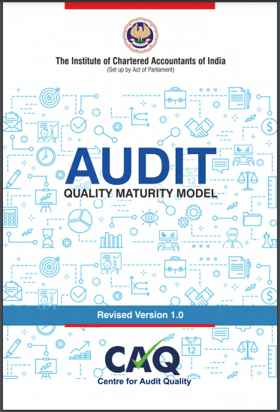
AUDIT QUALITY MATURITY MODEL (AQMM)
Measures Audit Quality maturity at firm level.
Cross-functional evaluation model for practicing firms.
Provides a roadmap to improve Audit Quality.
Practice units can evaluate themselves on Practice Management (Operation), Human Resource Management and Practice Management – Strategic / Functional.
Mandatory for certain categories of firms.

Slide 16
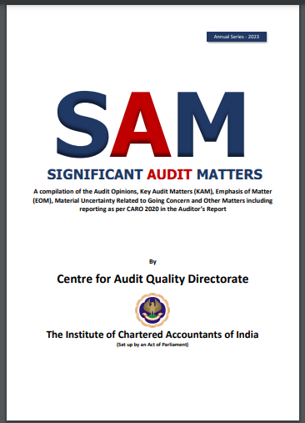
PUBLICATION ON
SIGNIFICANT AUDIT MATTERS (SAM)
Compilation of the reporting of Modified Opinions, Key Audit Matters (KAM), Emphasis on Matter (EOM), Other Matter, Material Uncertainty relating to going concern and Internal Financial Controls.
Reporting under various clauses of CARO 2020 is also included.
Unique reporting covering 450+ listed companies presenting different issues reported by auditors.
E-publication providing ease of searching.

Slide 17
UTILITY FOR BANK BRANCH AUDIT
Facilitates “Anywhere-Anytime” monitoring of audit procedures at bank branches.
Ensures compliance with audit procedures outlined in ‘Guidance Note on Audit of Banks’ and ‘Technical Guide on the Long Form Audit Report’.
Easy to use and navigate.
Prepares firms for Peer Review with proper documentation.

Slide 18
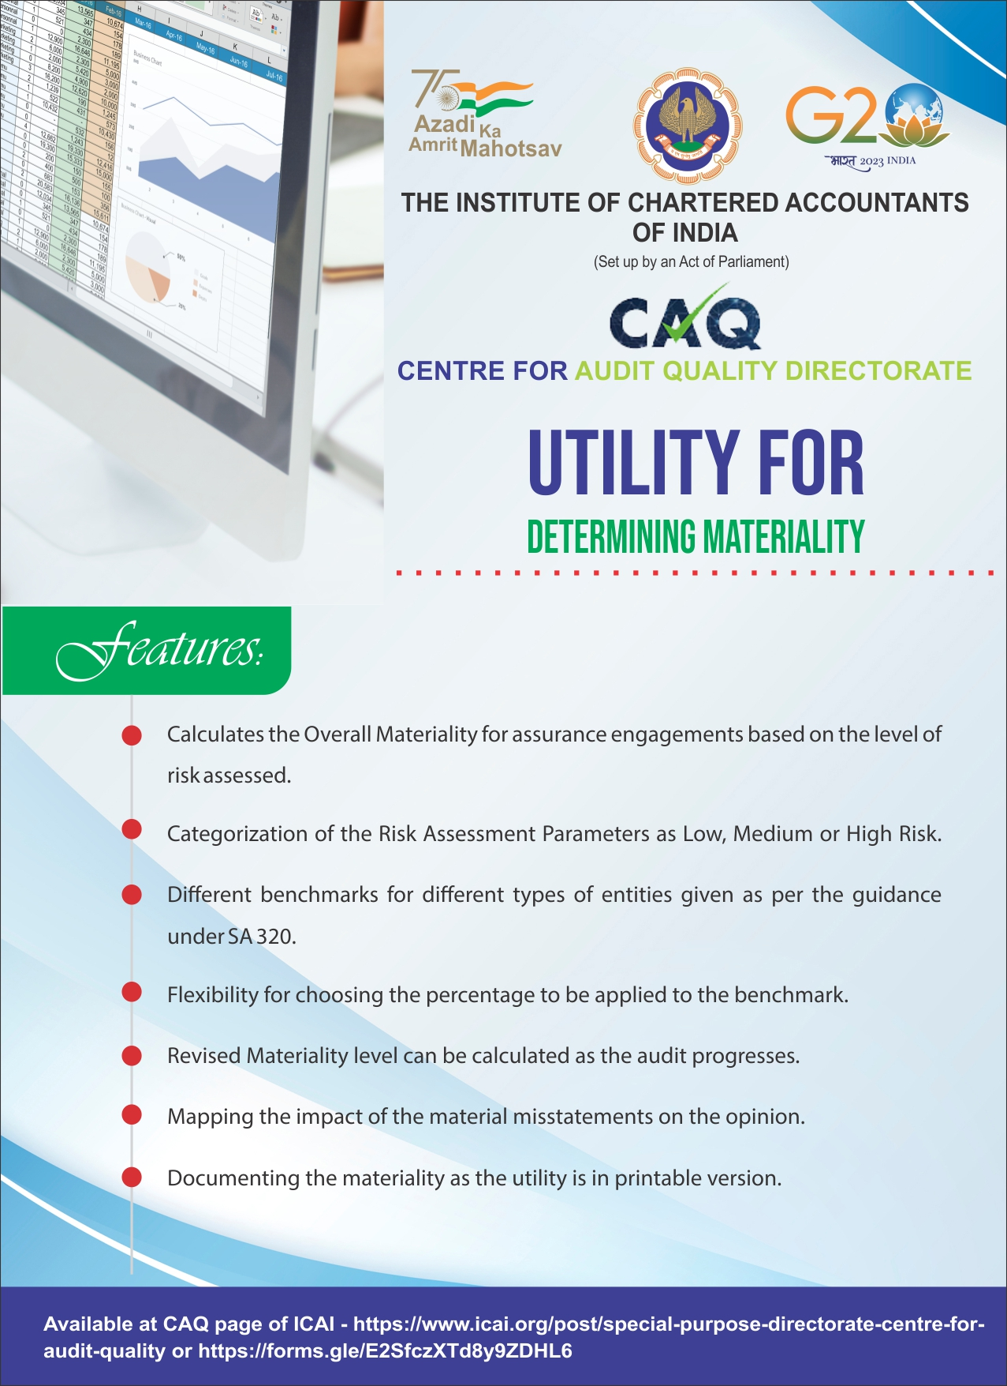
UTILITY FOR DETERMINING MATERIALITY
Handholding measure for assisting the firms in smooth conduct of audits.
Enables users to calculate Materiality threshold for Statutory Audit of an entity.
Categorises Risk Assessment parameters as low, medium or high.
Assists in forming of an Audit Opinion after considering impact of total Material Misstatements.

Slide 19
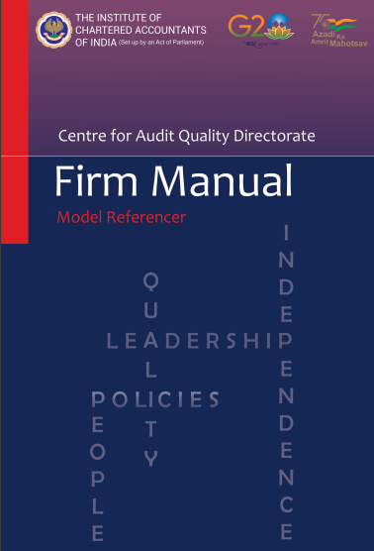
PUBLICATION ON
FIRM MANUAL – MODEL REFERENCER
A Model Referencer for firms to streamline operations and also improve efficiency and effectiveness.
Aids in framing a set of policies which can be modified to suit the requirements as per structure and size.
Prepared on the basis of requirements of SQC 1.
Enables a practice unit to enhance their AQMM scores in areas of Operations and Human Resources.
Makes firms future ready.

Slide 20
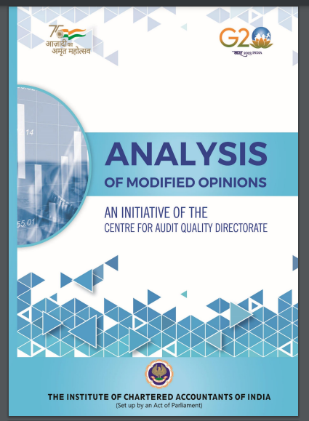
PUBLICATION ON
ANALYSIS OF MODIFIED OPINIONS
Compilation of modified opinions in the auditor’s reports.
Aims at educating readers on various subject matters of modifications.
Exhibits how modified opinions are generally presented in the audit reports issued by various practice units.
Categorisation of broad reasons for modified opinions with analytical presentations.

Slide 21
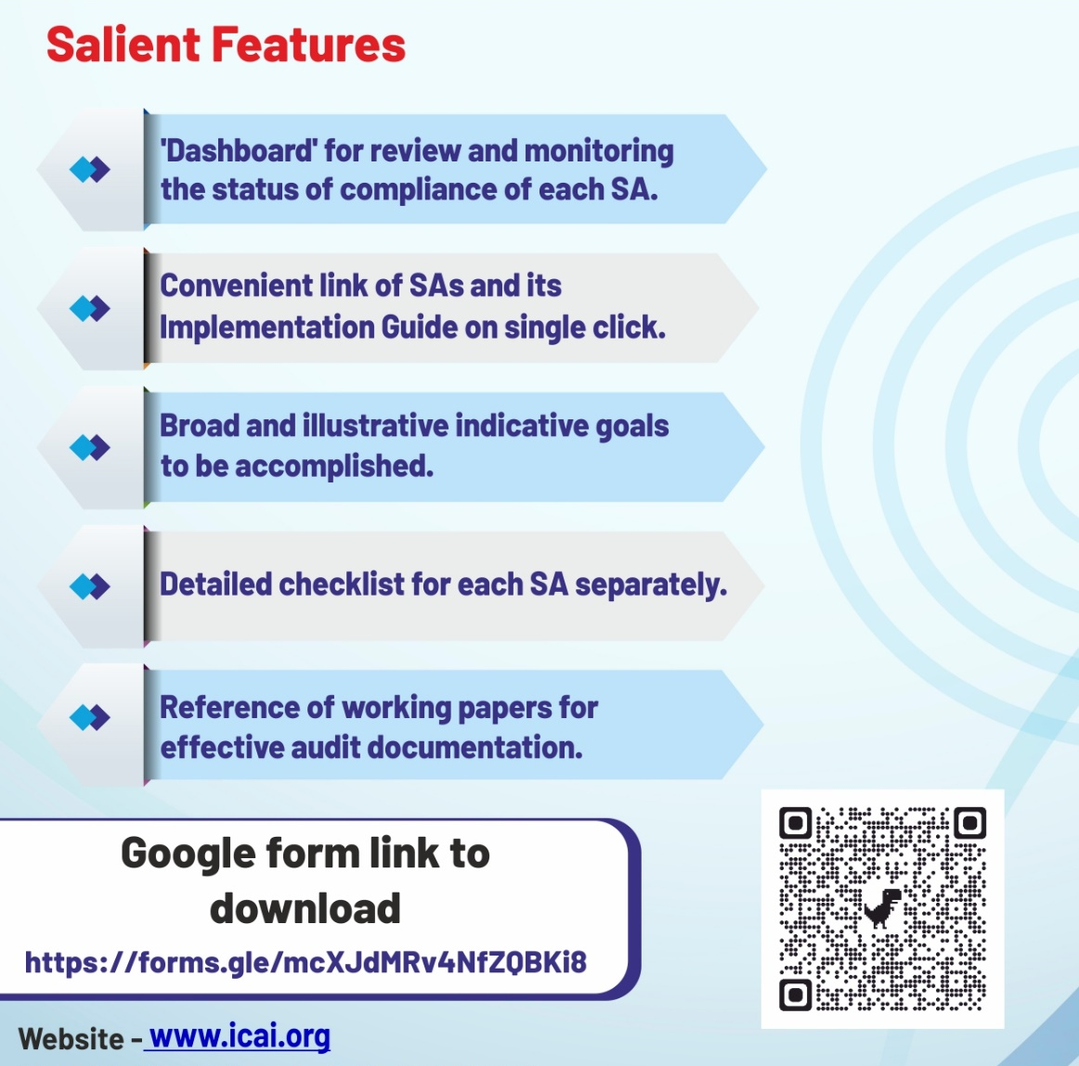
REVIEW & MONITORING TOOL FOR
STANDARDS ON AUDITING COMPLIANCE
Covers checklists on all Standards on Auditing as a measure for assisting firms in compliance with the SAs.
Enables review, monitoring and documentation of SA compliance effortlessly.
Tracks progress by using the ‘Work Status’ dropdown summarized in the Dashboard.
Stores record of team members and time taken for each audit.

Slide 22
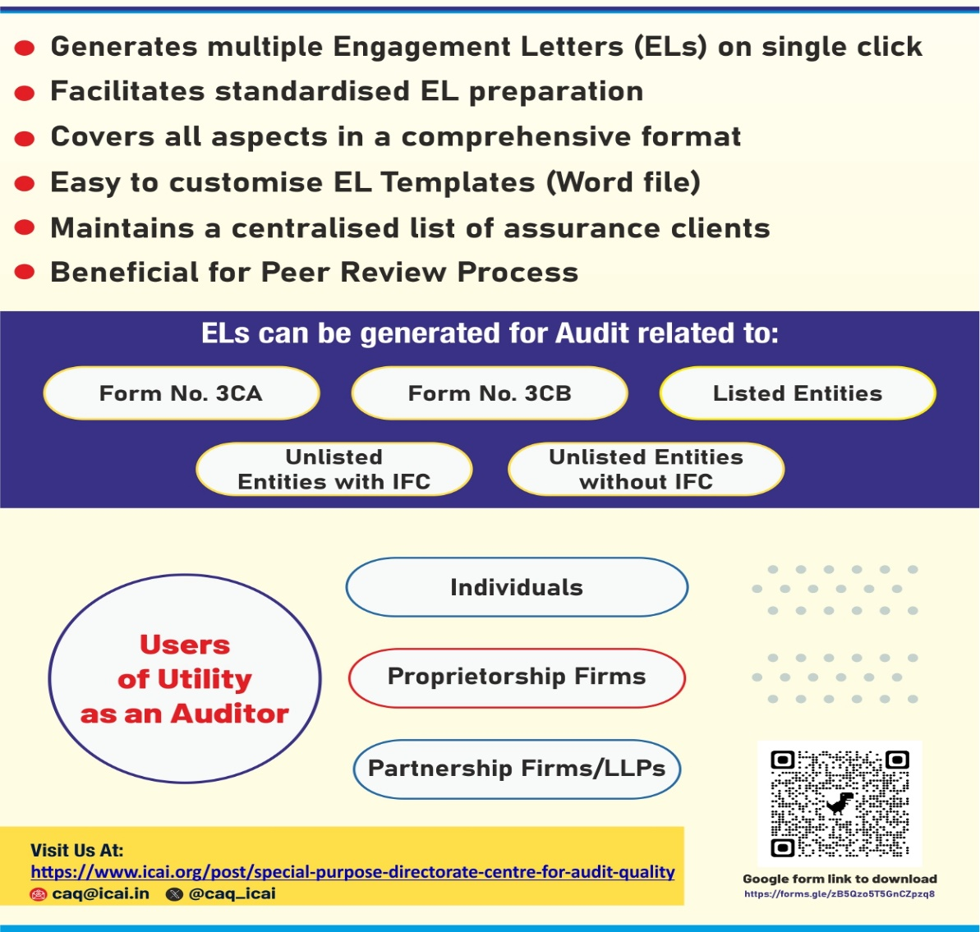
UTILITY ON ENGAGEMENT LETTERS
Facilitates auditor to effortlessly create multiple engagement letters for assurance clients.
Enables maintenance of master list of assurance clients which can help in Peer Review.
Saves valuable time and eliminates the usual complexities associated with engagement letter preparation.
Comprehensive template that can be customised by practice units.

Slide 23
CERTIFICATE COURSE - EXECUTIVE MASTER
PROGRAM NEW AGE AUDITORS
Executive Master Program - New Age Auditors
Successfully completion of 7 Online Batches.
Key features of the Course includes:
Right mix of learning of Assurance and New Age Technologies.
Focus on practical oriented case studies & Group Discussion for SAs.
Hands on training in data analysis, Robotic Process Automation, Cloud Computing, Blockchain Technology, Cyber Security, Internal Financial Controls, AI and Big data.
Comprehensive Background Material
7 days course duration with 30 hours CPE credit
*Course will be conducted in physical mode.

Slide 24
QUALITY CAFÉ SESSION:
A VIRTUAL SERIES ON AUDIT QUALITY
Regular webinar with 2-hour interactive panel discussion by Audit experts on elements contributing to Audit Quality.

Slide 25
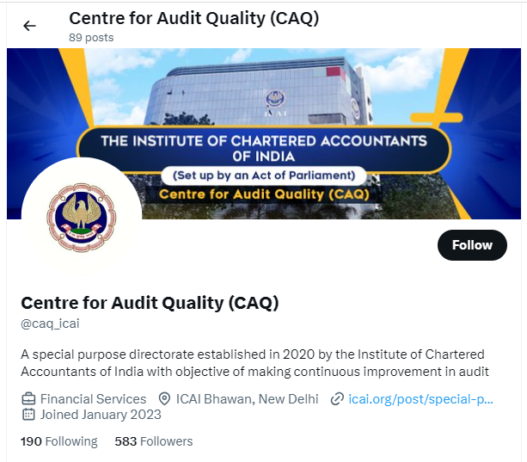
DID YOU KNOW?
‘Did you know?’ series in the form of Questions & Answers on X (formerly Twitter) to raise level of awareness and understanding on various elements of Audit Quality.

